Slide 1

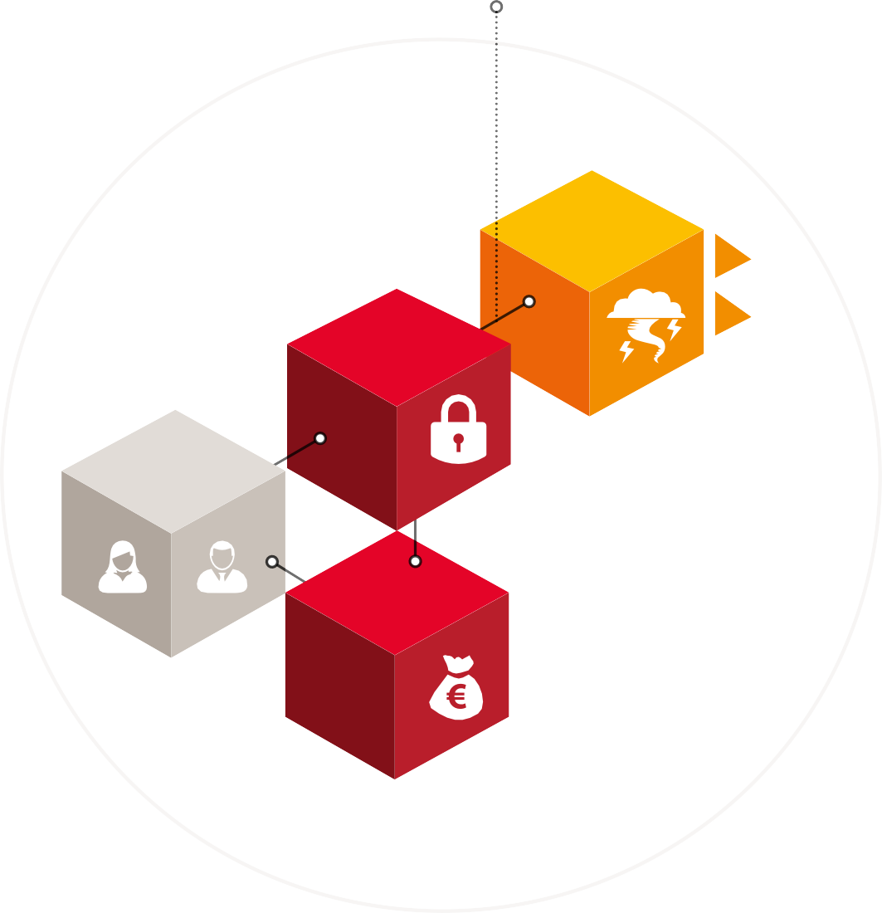
Revolutionizing Crowdfunding: Unveiling the Smart Contract Solution for Kickstarter - Like Platforms
Escrow
Smart Contract
Refund of premium surplus
Lecturer | Student
Paul Laird | Thi Thuy Trang Cao – 20008109 Gauri Shingane – 20018204
PwC | 15

Slide 2


Autonomy
The blockchain works according to the rules set by its members.
There is no need for a central decision-making body.
The blockchain offers an audit trail that can be consulted at any time by all blockchain members.
Campaign owner
₁
Search for Vendor and Contributors
Transparency
Security
Operating data input on the blockchain is deemed secure owing to the stacking of the blocks.
Automation
SMART CONTRACT
Client accountability
₂
Support by Vendor
Implementation by Contributors
Each blockchain participant has rights and obligations
with regard to the blockchain community.
The rules set upstream by blockchain members via smart contracts allow for automatic settlement.
Vendor
Contributors
Background | Requirements Analysis | Design process | Final Design | Interaction Pattern

Slide 3
Functional Requirements
Technical Requirements
Create Campaign
Accept funds
Reward tokens
Blockchain platform
Programming language
Ganache & Mocha
Web3.js
Spending funds
Consensus for fund transfer requests
Security
End campaign
Background | Requirements Analysis | Design process | Final Design | Interaction Pattern

Slide 4
Defining the components
Security considerations
Campaign
Requests
Constructor initializations
Modifiers
Checks
Vendors
Contributors
Background | Requirements Analysis | Design process | Final Design | Interaction Pattern

Slide 5
CAMPAIGN
Components
Functions
Other components
Requests
createCampaign()
constructors
Vendors
contribute()
modifiers
refund()
Contributors
checks
endCampaign()
createRequest()
approveRequest()
finalizeRequest()
Background | Requirements Analysis | Design process | Final Design | Interaction Pattern

Slide 6
End Campaign
Transfer remaining funds to Contributors
6
6
Contribute to campaign
₁
Create Campaign
₂
Campaign owner
SMART CONTRACT
Contributors
₃
₄
Campaign manager create spend request
Contributors approve/reject
fund transfer request
5
Complete the transaction by sending funds to vendor
₂
Vendor
Get reward token for contribution
Background | Requirements Analysis | Design process | Final Design | Interaction Pattern

